Slide 1
Report on Country Statistics Dataset
COUNTRIES OF THE WORLD
Tete R Assignon

Slide 2
INTRODUCTION
This report provides an exploratory data analysis (EDA) of a dataset containing various socio-economic and demographic attributes of countries worldwide. The analysis focuses on understanding the distribution, relationships, and potential factors influencing GDP per capita across different regions. This dataset was chosen to examine how literacy, population density, and other socio-economic indicators may relate to economic prosperity, specifically GDP per capita.

Slide 3
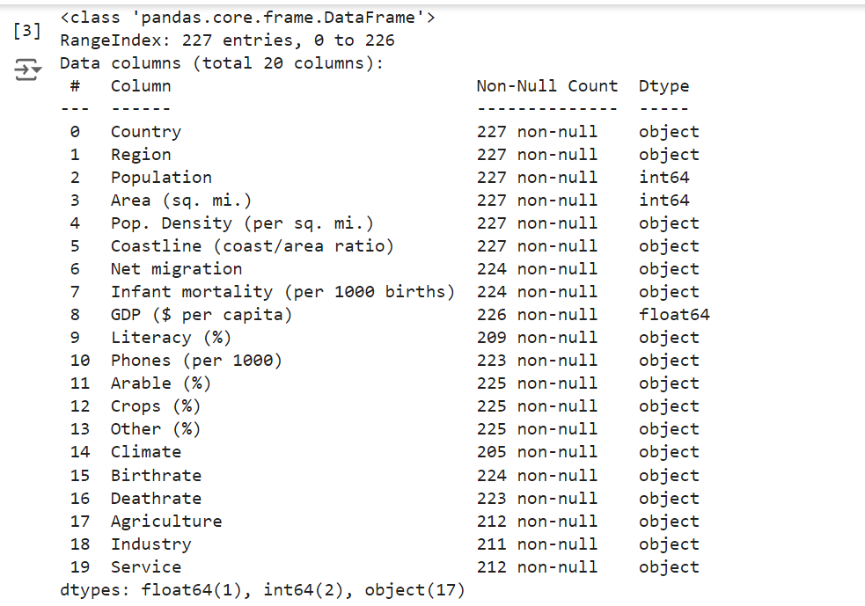

Slide 4
EDA PROCESS AND KEY OBSERVATIONS
Data Structure and Cleaning:
The dataset consists of 227 countries with 20 columns, including fields like Population, Area, Literacy (%), GDP ($ per capita), and Net migration.
Several columns contained numeric values stored as strings due to commas, which were cleaned by removing commas and converting the data to numeric format.
Missing values were detected in columns such as Literacy (%), Climate, and economic sector indicators (Agriculture, Industry, Service).

Slide 5
EDA PROCESS AND KEY OBSERVATIONS
Descriptive Statistics
Basic descriptive statistics, such as mean, median, and range, were calculated for each column.
These statistics revealed significant variations in GDP per capita, literacy rates, indicating diverse socio-economic conditions across countries.

Slide 6
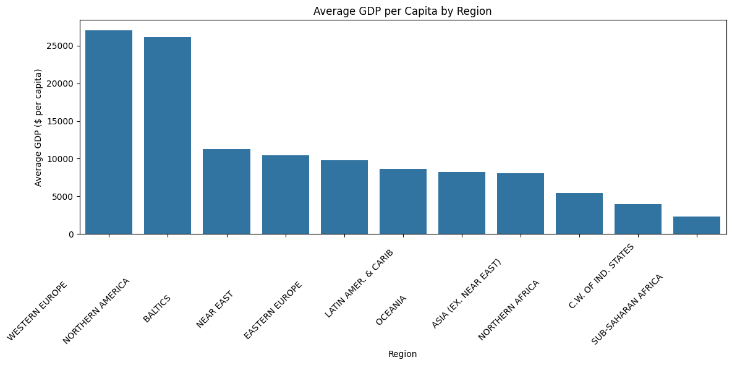
VISUALIZATIONS AND INSIGHTS
Western Europe and North America have the highest average GDP per capita, indicating a higher economic output per person, while Sub-Saharan Africa and South Asia have the lowest. This disparity suggests that regional factors like infrastructure, education, and resources contribute significantly to economic outcomes.

Slide 7
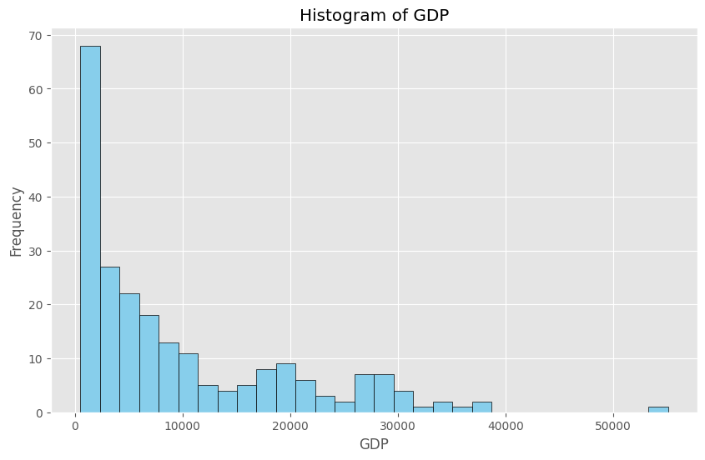
GDP PER CAPITA DISTRIBUTION
GDP per capita distribution is highly skewed, with a few countries having extremely high values, indicating economic disparity. The majority of countries have lower GDP per capita, emphasizing the economic divide between developed and developing nations.

Slide 8
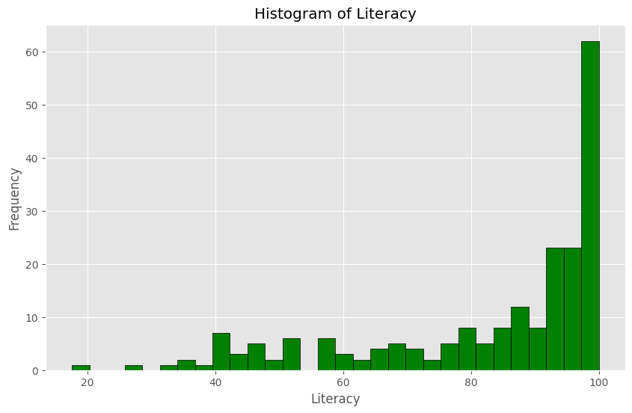
LITERACY RATES DISTRIBUTION
The majority of countries exhibit high literacy rates, clustering toward the higher end. This finding suggests that many countries are making significant strides in education, an essential driver of socio-economic progress.

Slide 9
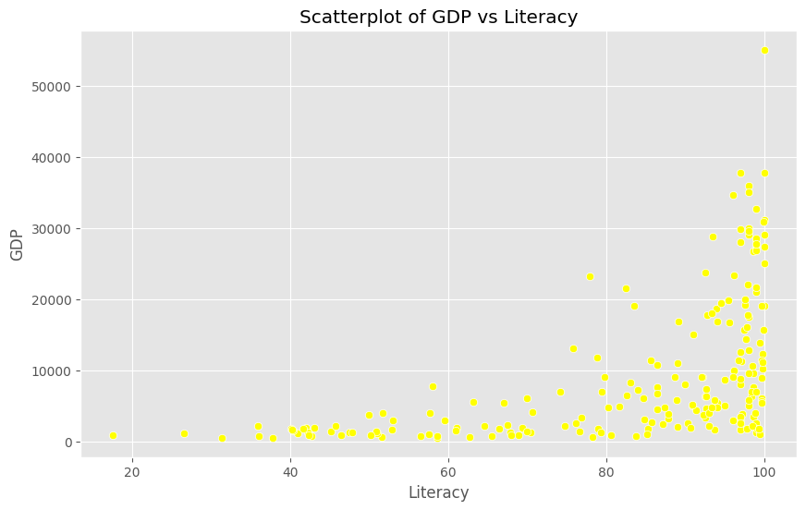
SCATTERPLOT OF GDP VS. LITERACY
A positive correlation between literacy rate and GDP per capita is evident, suggesting that higher literacy rates tend to correspond with higher GDP per capita. This correlation implies that literacy could be a critical factor in driving economic prosperity, as educated populations are better equipped to contribute to the economy

Slide 10
CONCLUSION
The analysis reveals several key findings:
Economic Disparities: There are significant regional economic disparities, with developed regions like North America and Western Europe exhibiting higher GDP per capita compared to regions like Sub-Saharan Africa.
Literacy as a Predictor of Economic Success: Higher literacy rates are positively associated with GDP per capita, indicating that investments in education may enhance economic growth.

Slide 11
Future Steps
Investigate Other Socio-Economic Indicators: Future research could explore how other factors, such as health care quality, political stability, or environmental factors, influence GDP.
Focus on Education Policies: Given the positive correlation between literacy and GDP, policies promoting universal literacy could be an effective strategy for economic development.

